Slide 1

Automatic Street Light Fault Detection
Team Members:
ARUN R G | (611220104007)
BALAJI S S | (611220104016)
DEEPESH KUMAR S | (611220104028)
GOKUL HARI R | (611220104048)
UNDER THE GUIDANCE OF Mr. T. KARTHIKEYAN, HEAD OF THE DEPARTMENT - CSE, DEPARTMENT OF COMPUTER SCIENCE AND ENGINEERING

Slide 2
ABSTRACT
“LightSense” aims to revolutionize urban lighting infrastructure by introducing an automated system for real-time street light fault detection, precise location tracking, and efficient maintenance. The current reliance on public reports or periodic surveys is time-consuming and inefficient. The project suggests a cost-effective solution utilizing Light Dependent Resistor (LDR) sensors integrated into an inexpensive board connected to a Modular Network Module for detecting changes in light intensity or the absence of light. The collected information, including a unique identification number for each street light pole, is transmitted to a regional hub and then relayed to the nearest Electricity Board (EB) Office mainframe for precise location determination and technician dispatch. The system goes beyond fault detection, providing a versatile framework for future enhancements. The project's workplan includes milestones, and the college facilities available for prototype development are essential. Industry support is sought, and financial assistance is required. The expected outcomes include faster response times, reduced costs, and overall improved urban lighting infrastructure.

Slide 3
PROBLEM STATEMENT
How the information of Damaged/Faulty Street Lights is passed to the EB office and subsequently The Technician. The Faults are either reported by the public who happen to notice it and take initiative to report it or by periodic survey of the street by the Technician who would then repair or replace it. The issues of both ways are obvious: The Former is heavily unreliable and is hard to prioritize among huge number of reports, while the later is extremely inefficient taking days or even months to complete but was only followed as there is no alternative to this. It is clear that this part of the pipeline can be optimized. A solution is to use wide scale IoT technologies to detect and report the faults in matter of seconds.

Slide 4
LITERATURE SURVEY
1. Smart streetlights in Smart City: a case study of Sheffield [Dizon, E., & Pranggono, B. (2022)]:
This paper addresses challenges in traditional street lighting, emphasizing the potential of smart streetlights for public safety.
It critiques the high electricity consumption and economic strain of conventional systems and the inefficiencies of static approaches. The paper examines streetlight utilities in Sheffield, exploring diverse lighting schemes adopted by councils. It reviews current implementations of IoT in streetlights and presents case studies from Doncaster and Edinburgh.
Utilizing the StreetlightSim simulator, the study evaluates four time-based schemes, revealing mixed results and suggesting the need for further analysis of adaptive approaches.
Technologies Used : StreetlightSim, GIS.

Slide 5
2. Smart streetlight system using mobile applications: secured fault detection and diagnosis with optimal powers [M. Kanthi., & Ravilla Dilli (2023)]:
The proposed system introduces a mobile application for secure brightness adjustments and utilizes an nRF24L01 radio transceiver for adaptive streetlight operation. Key features include failsafe mechanisms, Light-Dependent Resistors (LDRs) for automatic brightness adjustments, and smartphone accessibility.
Results demonstrate effective monitoring, control capabilities, and significant average power savings of 53.45%, 44.76%, 39.39%, and 32.25% for idle mode brightness levels of 10%, 20%, 30%, and 50%, respectively.
This research contributes insights into energy-efficient and secure solutions for urban infrastructure within the literature review.
Technologies Used : LDR Sensor, Radio and Bluetooth Transmision.

Slide 6
3. IoT based Automatic Damaged Street Light Fault Detection Management System [Ashok Kumar Nanduri, Siva Kumar Kotamraju, G L Sravanthi, Sadhu Ratna Babu (2020)]:
The study utilizes Internet of Things (IoT) technology to automate the ON/OFF functionality of street lights based on weather conditions and observes the working status of the lights.
A Light Dependent Resistor (LDR) sensor detects environmental changes, enabling automatic control of street lights. In instances where a street light is damaged or fails to turn on at night, the LDR sensor sends notifications to authorized personnel, including the location determined through GPS.
The study also emphasizes the pre-identification of damaged street lights based on the expiration of lamp life, contributing to efficient energy management and conservation efforts.
Technologies Used : GSM, LDR, GPS, Raspberry, Twillio.

Slide 7
4. Street Light Controlling and Monitoring of Fault Detection using LoRa
[N. Sravani, Y. Latha, G. Nirmala (2021)]:
Lighting appliances consume a substantial amount of energy, therefore improving efficiency and detecting faults quickly is a key task. Depending on the nature of the application, two distinct model techniques are used in this study.
IEEE 802.11 wireless technology is utilized in limited regions or confined premises where all appliances are connected to a cloud.
The second variant, which is similar to the street lamp pole, Wired setup is used to eliminate range issues when the number of appliances develops solely in one direction. When a problem is found, that specific pole number problem is immediately uploaded to a webpage.
Technologies Used : IoT, LoRa, Things speak.

Slide 8
5. Simulators, Emulators, and Test-beds for Internet of Things: A Comparison
[N D Patel, B M Mehtre, Rajeev Wankar (2019)]:
The state of IoT is under rigorous research & deployment by several researchers across the globe to develop new algorithms, techniques, and protocols to secure IoT networks further.
In this paper, they compare sixteen simulators (IOTSim, IoTIFY, Bevywise-IoT, etc), four emulators (Cooja, NetSim, MAMMotH, NCTUns 6.0), and six test-beds (MBTAAS, FIT IoT-LAB, etc) for IoT on the basis of Scope, Type, Programming language, IoT layers, Scale of Operation, IoT Standards, API Integration, Cyber Resilience, Service Domain, and Security Measures. Its comparison helps for modeling techniques, proper simulation, and testing for algorithm validation/proof-of-concept implementation in IoT.
This comparison will help to support researchers and developers for choosing suitable tools for their application. This will help in testing the research ideas before moving towards live implementation.
Technologies Used : IoT Emulators, IoT Simulators, IoT Test-beds.

Slide 9
PROPOSED SOLUTION
Our Project uses an LDR Sensor to detect the reduction of intensity or absence of Light, The Sensor would be connected to an inexpensive board that transmits the information through an Modular Network Module which uses an GSM module or any networking technology appropriate to an regional hub which encompasses an radius of several kilometers. The information Consists of the unique identification number given to the street light along with any telemetry we need from the pole. The Hub then relays the information to an nearest EB Office mainframe which would resolve the Unique ID to the location of the same and dispatch or alert a Technician for an repair.

Slide 10
SYSTEM SPECIFICATION
HARDWARE USED :
Light Dependent Resistor
Arduino UNO
GSM Module
SOFTWARE USED :
WokWi (Online Arduino Emulator)
Micropython
MQTT (Hive MQ)

Slide 11
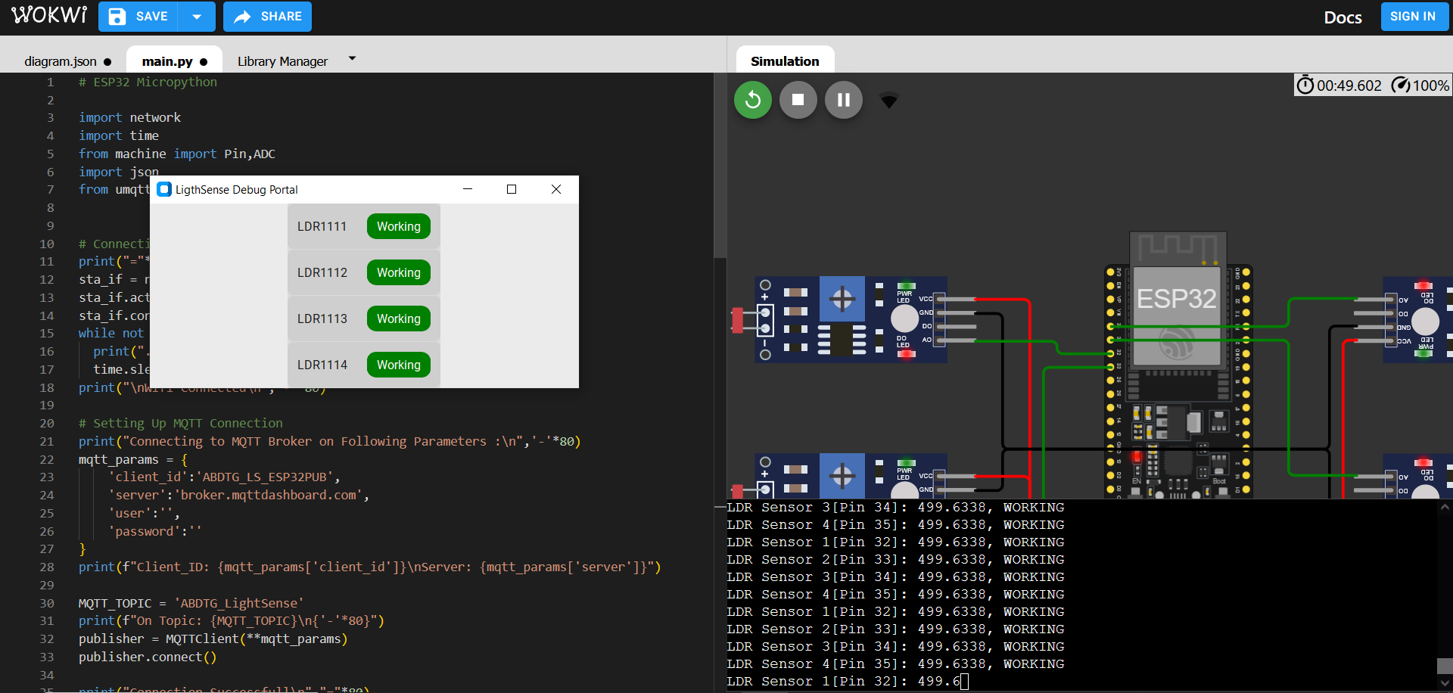
Project Showcase

Slide 12
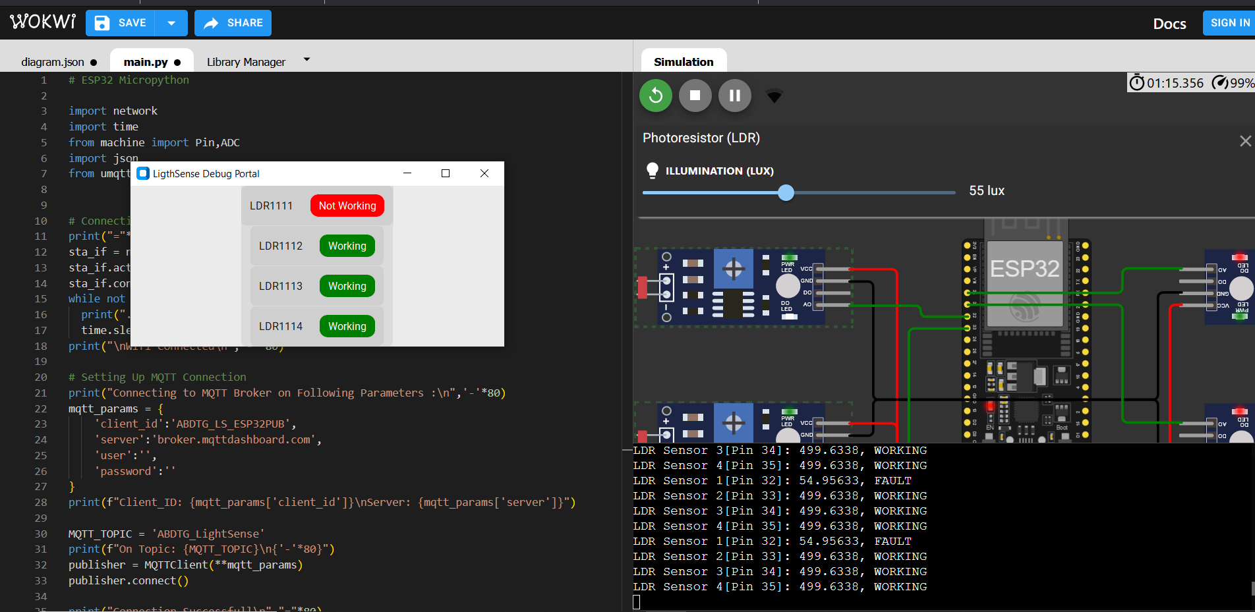
Project Showcase

Slide 13


